Slide 1
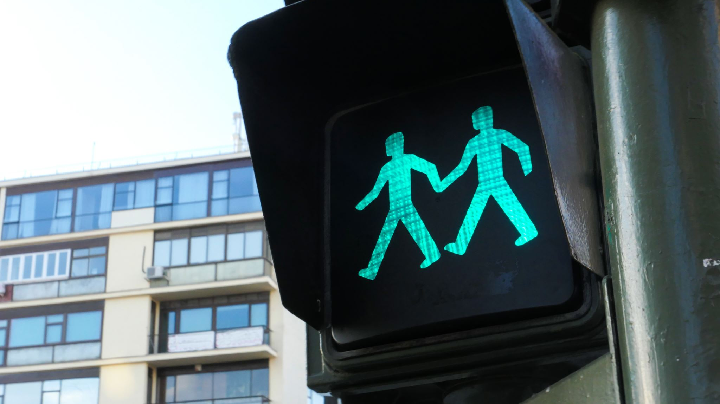
Safety Traffic Light
Lupita Todd
CEIS 114
DeVry University
Prof. Muqri

Slide 2
CEIS 114 Module 2
Project Plan for IoT Traffic Controller

Slide 3
ESP32 (Screenshot)
Microcontroller mounted and powered ON

Slide 4
ESP32 WiFi Scan
Screenshot of Serial Monitor showing the available networks

Slide 5
CEIS 114 Module 3
Creating the Traffic Controller

Slide 6
Picture of circuit with working LEDs
ESP 32 Board
Colored LEDs: Red, Yellow and Green
Wires
Breadboard

Slide 7
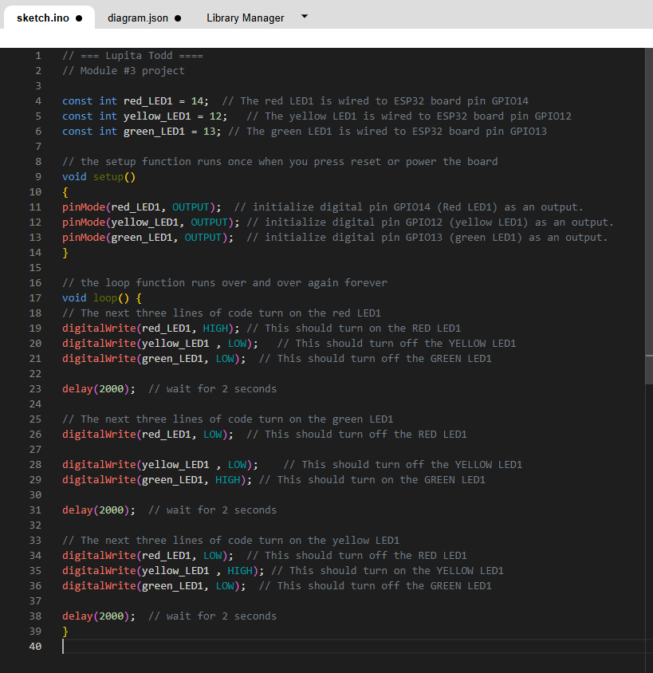
Screenshot of code in the Code Editor
Screenshot of code in the Wokwi Code Editor

Slide 8
CEIS 114 Module 4
Creating a Multiple Traffic Light Controller

Slide 9
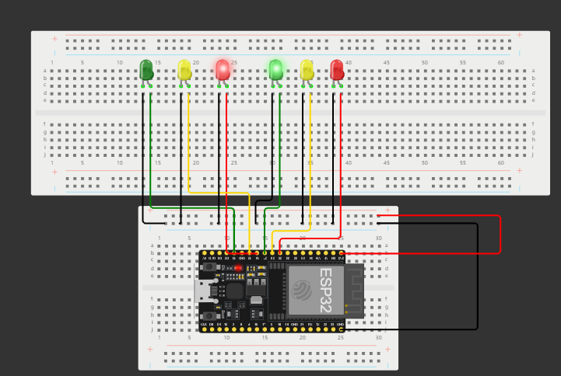
Picture of circuit with working LEDs
ESP 32 Board
Colored LEDs: Red, Yellow and Green (two sets)
Wires
Breadboard

Slide 10
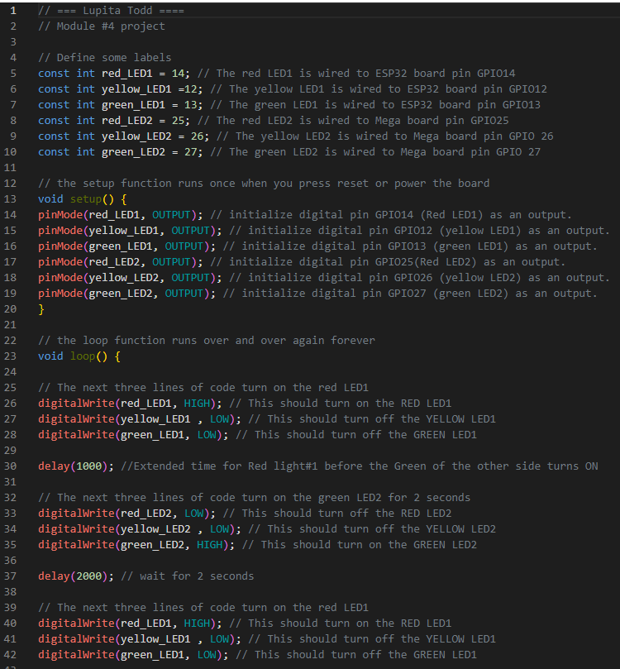
Screenshot of code in Wokwi
Screenshot of code Wokwi Code

Slide 11
CEIS 114 Module 5
Creating a Multiple Traffic Light Controller with a Cross Walk

Slide 12
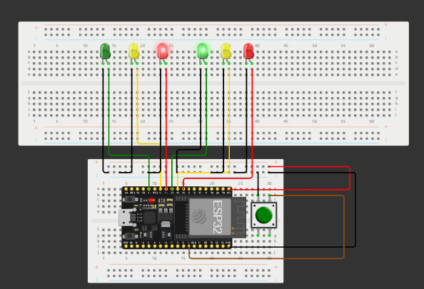
Screenshot of circuit with working LEDs
ESP 32 Board
Colored LEDs: Red, Yellow and Green (two sets)
220 Ohm Resistors (optional)
Push Button
Wires
Breadboard

Slide 13
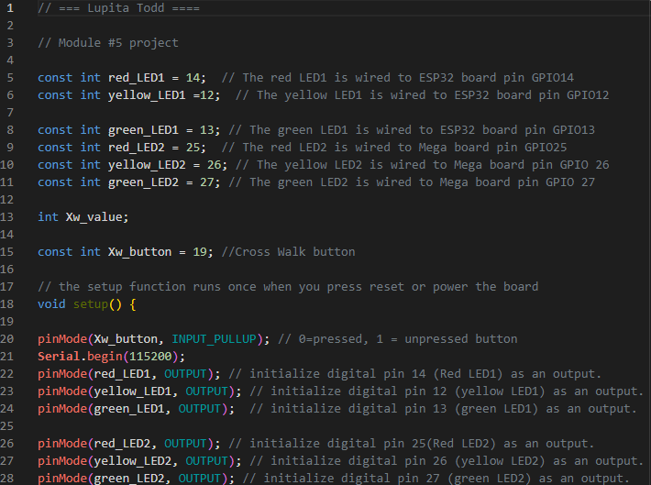
Screenshot of code in Wokwi
Screenshot of code in Wokwi Code Editor

Slide 14
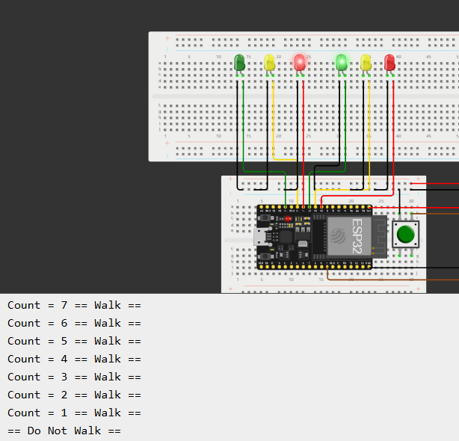
Screenshot of Serial Monitor in Wokwi
Screenshot of output in Serial Monitor

Slide 15
CEIS 114 Module 6
Creating a Multiple Traffic Light Controller with a Cross Walk and an Emergency Buzzer

Slide 16
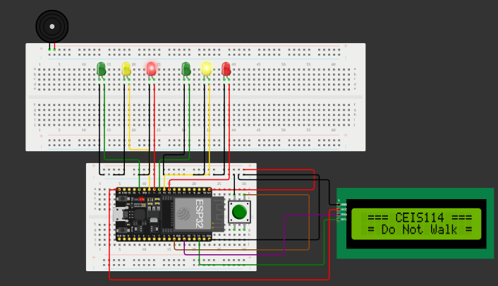
Picture of circuit with working LEDs and LCD display
ESP 32 Board
Colored LEDs: Red, Yellow and Green (two sets)
220 Ohm Resistors (optional)
Push Button
LCD Unit with Message Display
Wires
Breadboard

Slide 17
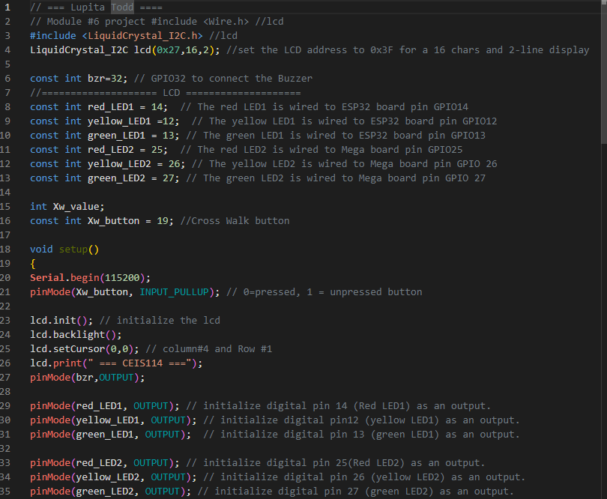
Screenshot of code in Code Editor
Screenshot of code in Code Editor

Slide 18
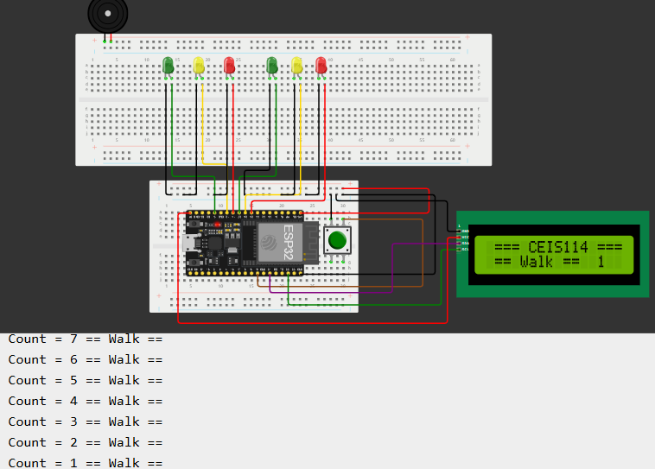
Screenshot of Serial Monitor
Screenshot of output in Serial Monitor

Slide 19
CEIS 114 Week 7 Project
Creating a Multiple Traffic Light Controller with a Cross Walk and an Emergency Buzzer with secured IoT Control via Web

Slide 20
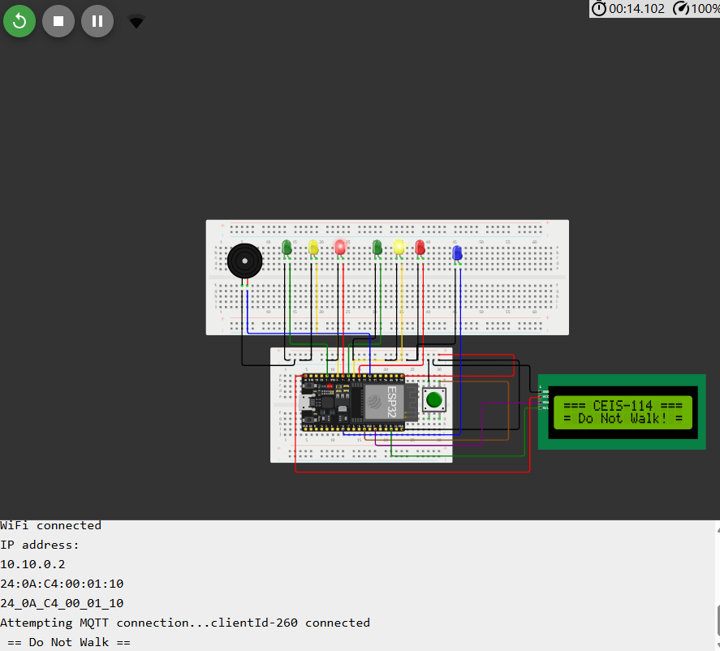
Screenshot of circuit with working LEDs and LCD display (Building/Operation)
ESP 32 Board
Colored LEDs: Red, Yellow and Green (two sets)
One Blue LED – Emergency Light
Push Button
LCD Unit
Buzzer
Wires
Breadboard

Slide 21
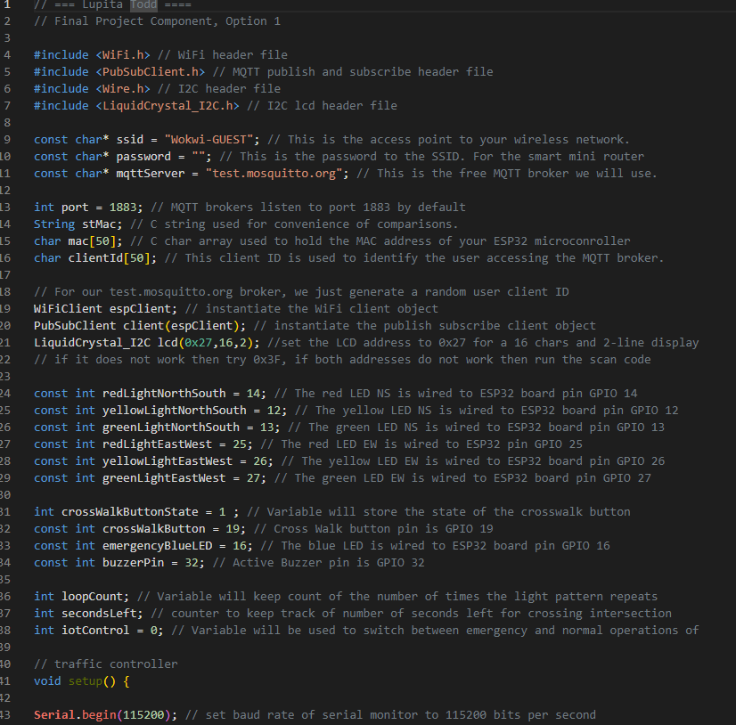
Screenshot of code in Code Editor (Testing)
Screenshot of code in Code Editor

Slide 22
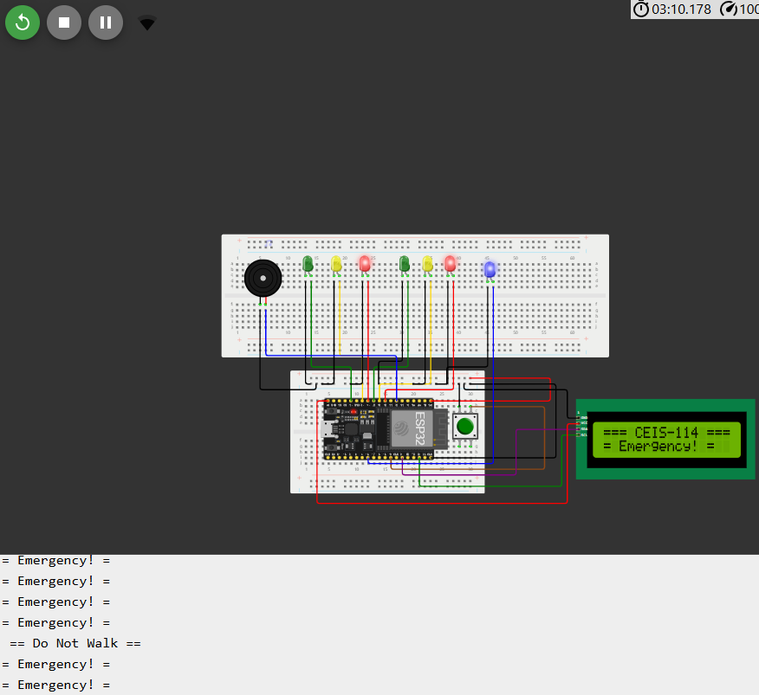
Screenshot of Serial Monitor (Testing)
Screenshot of output in Serial Monitor

Slide 23
Challenges Faced
One challenge I encountered was resizing the ESP32 board, but by practicing zooming in and out with my mouse, I became more comfortable navigating the interface. I also faced difficulties with the crosswalk button initially, but after holding it down for a few extra seconds, I successfully obtained the expected “walk” output. These challenges helped me improve my problem-solving skills and adaptability while working with the WOKWI simulation.

Slide 24
Career Skills Obtained
apply network principles to setup a Local Area Network.
apply various methods to troubleshoot a Local Area Network.
Produce an electronic module designed for a specific function in a digital electronic system install and configure Operating Systems in a Personal Computer.
Network and secure a digital device deployed into the IoT apply various methods to troubleshoot Operating systems in a Personal computer.
secure and document network resources and infrastructure.
Produce a networked and digital electronic device integrated into the IoT

Slide 25
Conclusion
Through this project, I progressively built a traffic light simulation using the ESP32 microcontroller in WOKWI, starting with a basic LED setup and gradually adding a second set of lights, a crosswalk with a push button, a buzzer, and an LCD panel for enhanced functionality. Each module refined the system, reinforcing my understanding of microcontroller programming, circuit design, and real-time traffic control. This hands-on experience highlighted the importance of iterative development, testing, and optimization in embedded systems and IoT applications.

Slide 26
Credited Sources
https://wokwi.com/
https://napkforpc.com/apk/snr.lab.iotmqttpanel.prod/
www.Microsoft.com
www.powerpoint.com
Project recording
Lecture recording

