Slide 1
Smart Home Security System
CEIS101 Final Course Project
Module 7
Lupita Todd
Professor Kristopher Velazquez

Slide 2
Introduction
This is a IOT device that simulates a smart home automation and security system. It monitors the home condition. It uses sensors that trigger the LED lights indicating when the door is open and closed also triggering an alarm sound.
The sensors trigger the LED lights indicating when the door is open and closed, also triggering an alarm sound.
Tools used: PowerPoint, Tinker CAD, Microsoft Excel, Notepad.
Hardware used: Arduino board circuit, bread board, LED automated lights (red, yellow, green, blue), active buzzer, ultrasonic distance sensor, photoresistor (light dependent resistor), wires, USB to type B cable, photocell, passive buzzer, ground wires, resistor.

Slide 3
Circuit (screenshot)

Slide 4
Code (screenshot)

Slide 5
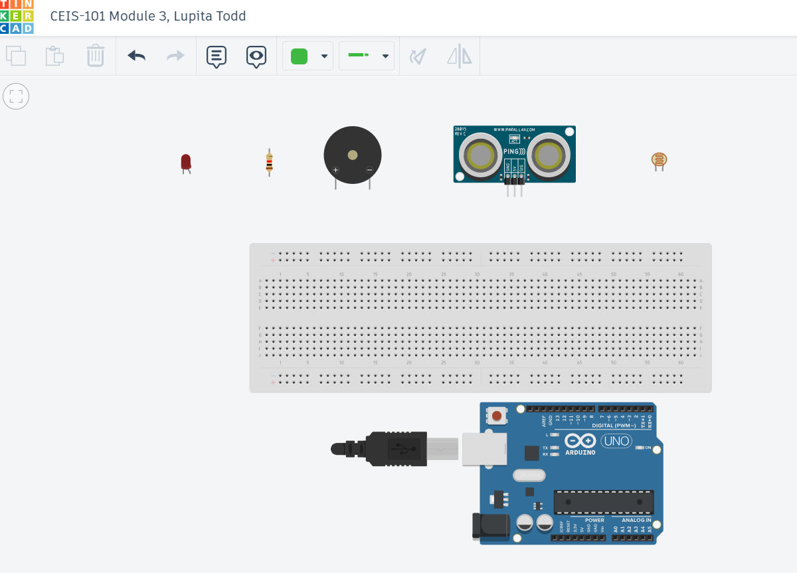
Organization of Project Components (picture)
Arduino Uno
Breadboard
Resistor 10kΩ
LEDs
Ultrasonic Sensor
Piezo
Photoresistor

Slide 6
Circuit with red LED on (picture)

Slide 7
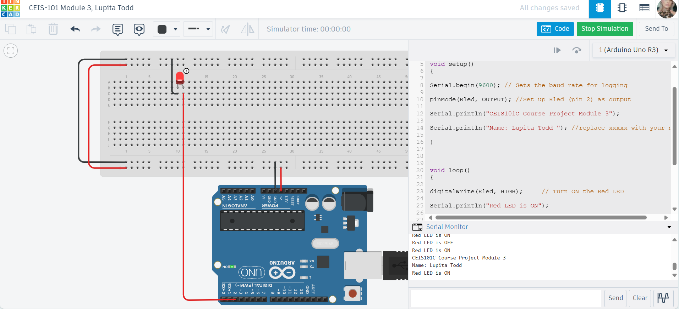
Serial Monitor (screenshot)

Slide 8
Circuit of door closed with Green LED ON (picture)

Slide 9
Circuit of door open with Green LED OFF (picture)

Slide 10
Arduino Code (screenshot)

Slide 11
Serial Monitor (screenshot)

Slide 12
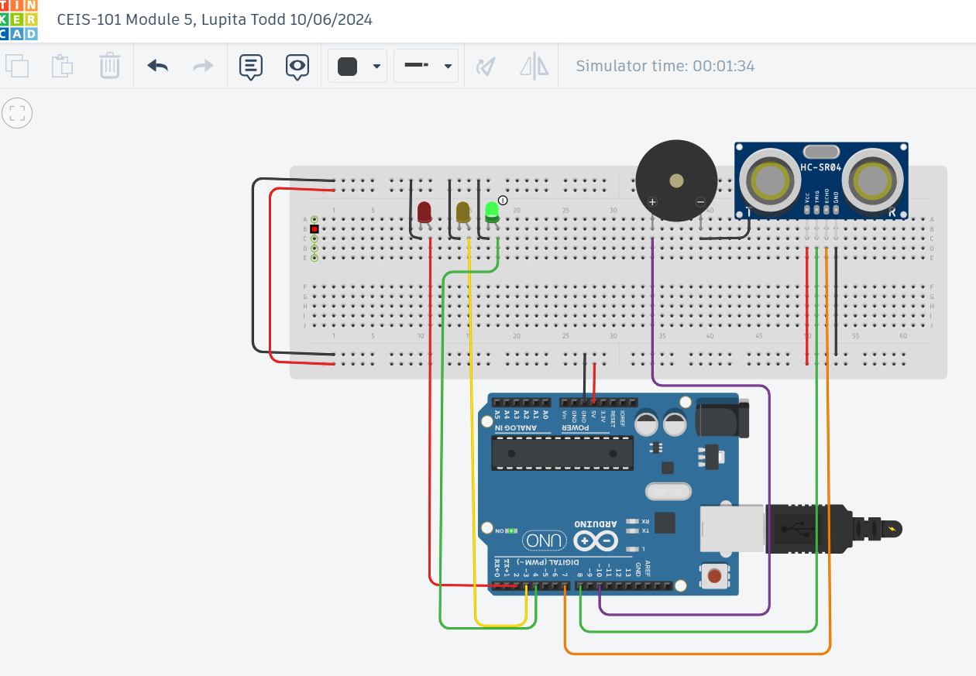
Circuit with green LED on (picture)

Slide 13
Circuit with yellow LED on (picture)

Slide 14
Circuit with red LED on (picture)

Slide 15
Arduino Code (screenshot)

Slide 16
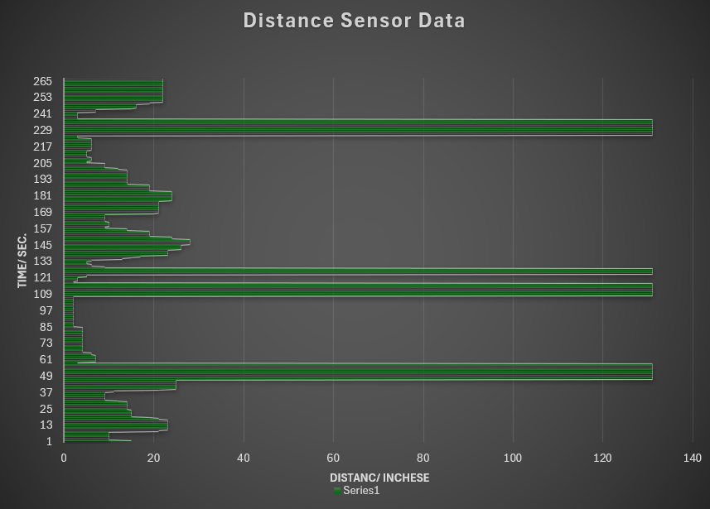
Plot of data (graph from Excel)

Slide 17
Circuit with automated LED off (picture)

Slide 18
Circuit with automated LED on (picture)

Slide 19
Arduino Code (screenshot)

Slide 20
Serial Monitor (screenshot)

Slide 21
Challenges/Lessons Learned
I did have a few challenges when locating the correct ground wire points to the correct locations. By zooming in on the circuit board I was able to make the correct adjustments. Taking extra moments to learn the different hardware had been necessary to get the functions to work correctly. Using the different color wires helped me keep my wires connected properly.
I learned that being patient with the movements of the mouse while clicking the wires allowed me to be able to clean up my work and provide an orderly production. I learned how to use PowerPoint design in a creative way. While saving my deliverables in order with the titles helped me overlook any mistakes and make those changes needed for grading.

Slide 22
Career Skills
I now have knowledge of the hardware and the descriptions which will allow me to work with circuit boards in my career. Arduino Uno, Breadboard, LEDS and how to wire them to work with a ground wire, active buzzer, ultrasonic distance sensor, Photoresistor, USB to type B cable, and passive buzzers.
Building projects on my own will solidify my skills and give me confidence when solving real-world problems by showcasing my understanding of hardware components and how they can be integrated.

Slide 23
Conclusion
Knowing how to troubleshoot wiring, power issues, or sensor integration problems will increase my confidence. Being able to solve issues on the spot is an essential skill in hardware development. I have enjoyed learning about the Arduino Uno and how Tinker CAD can help me improve my skills for my future educational goals in computer science.

Slide 24
References
https://www.tinkercad.com
https://www.microsoft.com/en-us/microsoft-365/powerpoint
https://www.instructables.com/Multiple-LEDs-Breadboards-With-Arduino-in-Tinkerca/

